Slide 1
Unveiling Culinary Insights:
Exploring the
Zomato Dataset

Slide 2
Introduction:
Today, we embark on a data-driven journey that takes us deep into the heart of one of the world's most beloved food ordering platforms – Zomato.
I am delighted to be your guide on this exploration. As a passionate food enthusiast and data analyst, I have been captivated by the rich tapestry of information that the Zomato dataset holds. Together, we will uncover intriguing trends and gain valuable insights into the global dining and food ordering landscape.

Slide 3
About:
What is Zomato? Zomato, founded in 2008, has evolved into a global restaurant discovery, food delivery, and dining platform. With a vision to provide the best dining experience to food lovers worldwide, Zomato has become a trusted companion for millions seeking gastronomic delights founded by Deepinder Goyal and Pankaj Chaddha.
Global Presence Operating in multiple countries and cities, Zomato has established itself as a go-to resource for discovering restaurants, reading reviews, and placing food orders right at your fingertips.
The Zomato App At the core of Zomato's success lies its user-friendly app, designed to empower users with seamless navigation and a comprehensive database of eateries, menus, and culinary experiences.
User-Generated Content One of Zomato's strengths is its reliance on user-generated content, where food enthusiasts and diners share their honest experiences, ratings, and reviews, shaping the choices of millions of others.
Food Delivery Services Beyond restaurant discovery, Zomato offers online food delivery services in select countries, making it a one-stop platform for both dine-in and at-home culinary experiences.

Slide 4
Preprocessing:
Understanding:
representation:
Relatively straightforward, user-friendly and easy to understand.
Loss of productivity costing consumers thousands of dollars
Missing values:
Transformation:
Remarkable quality of dataset is scarcity of missing of null values
Amalgamated data from 5 JSON files, combining into single dataset
Format:
Transformed the merged dataset into a CSV to streamline our analysis.

Slide 5
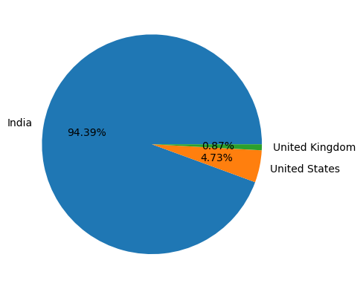
Market comparison:
Notes:
Our analysis showcases the diversity of Zomato's user base and the popularity of its services in different countries.
At the forefront, we have India, contributing a staggering 94.39% of all transactions. This dominance is a testament to Zomato's deep-rooted influence in the Indian dining landscape.
reveals notable user engagement in other countries. The USA (4.73%) and the UK (0.87%) emerge as significant contributors

Slide 6
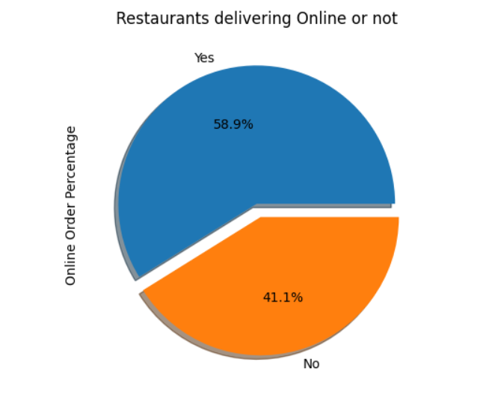
ONLINE DELIVERY:
Notes:
Our analysis showcases the diversity of Zomato's user base and the popularity of its services in different countries.
At the forefront, we have India, contributing a staggering 94.39% of all transactions. This dominance is a testament to Zomato's deep-rooted influence in the Indian dining landscape.
reveals notable user engagement in other countries. The USA (4.73%) and the UK (0.87%) emerge as significant contributors

Slide 7
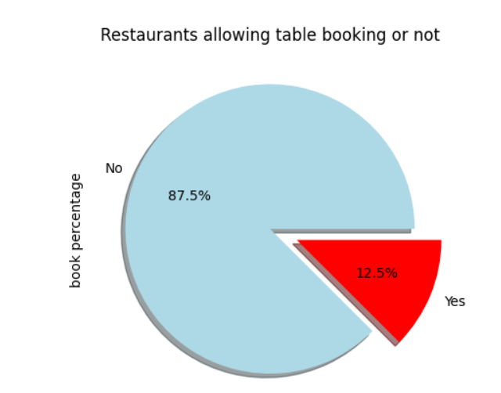
Table booking:
Notes:
Our analysis showcases the diversity of Zomato's user base and the popularity of its services in different countries.
At the forefront, we have India, contributing a staggering 94.39% of all transactions. This dominance is a testament to Zomato's deep-rooted influence in the Indian dining landscape.
reveals notable user engagement in other countries. The USA (4.73%) and the UK (0.87%) emerge as significant contributors

Slide 8
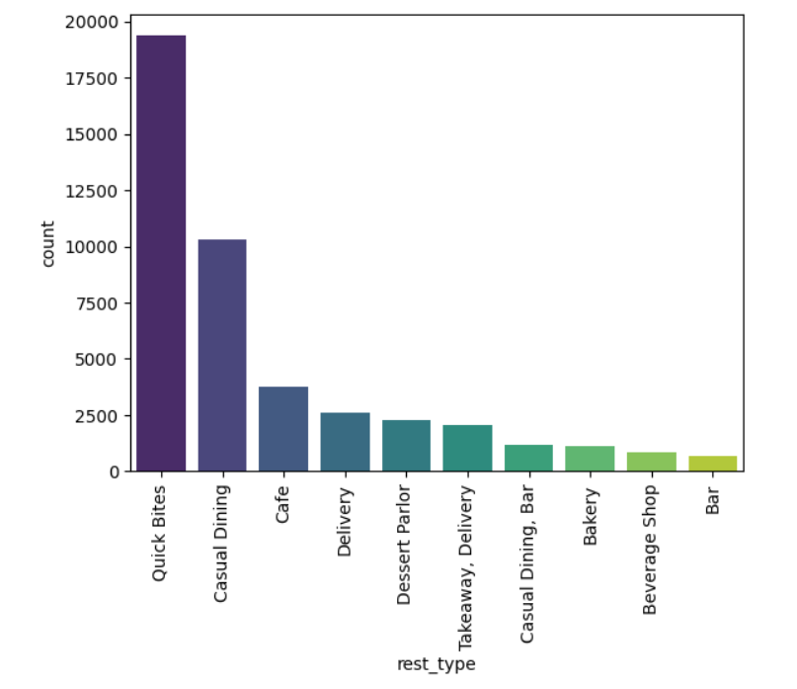
Type of restaurant :
Notes:
Our analysis showcases the diversity of Zomato's user base and the popularity of its services in different countries.
At the forefront, we have India, contributing a staggering 94.39% of all transactions. This dominance is a testament to Zomato's deep-rooted influence in the Indian dining landscape.
reveals notable user engagement in other countries. The USA (4.73%) and the UK (0.87%) emerge as significant contributors

Slide 9
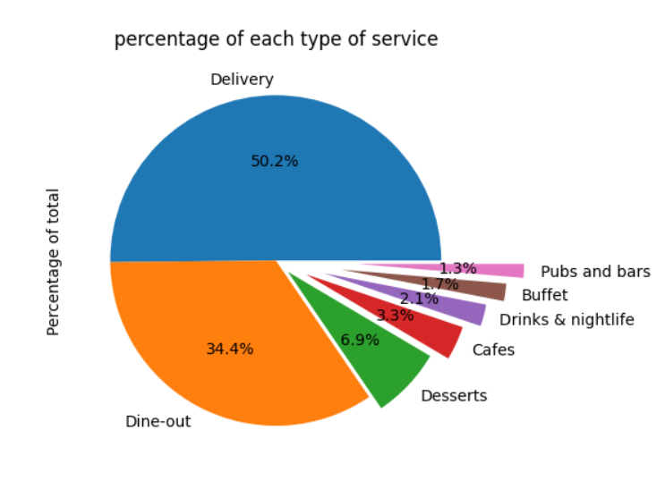
Restaurant services:
Notes:
Our analysis showcases the diversity of Zomato's user base and the popularity of its services in different countries.
At the forefront, we have India, contributing a staggering 94.39% of all transactions. This dominance is a testament to Zomato's deep-rooted influence in the Indian dining landscape.
reveals notable user engagement in other countries. The USA (4.73%) and the UK (0.87%) emerge as significant contributors

Slide 10
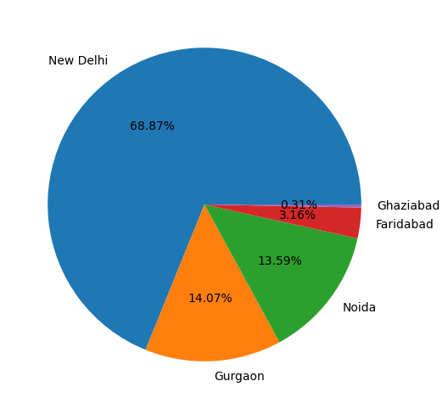
Indian business market:

Slide 11
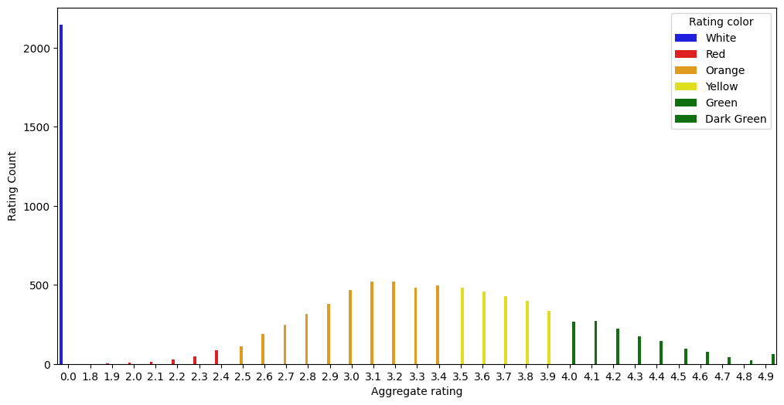
Ratings
Notes:
Our analysis reveals that the majority of restaurant ratings cluster between 2.5 and 3.5 stars. This spectrum represents a fascinating blend of moderate to above-average ratings, indicating that diners' preferences are not only varied but also moderately positive on the whole.

Slide 12
Zero rating enigma:
Zero Rating by Country? Upon closer examination, we found that a substantial number of zero ratings originate from Indian customers. This finding sparks questions about the underlying factors that contribute to such a trend.
The Intriguing Puzzle Why do Indian customers contribute significantly to zero ratings? Is there a cultural context, or are there specific experiences that lead to this pattern? These questions drive our exploration and encourage us to uncover insights that hold the key to this puzzle

Slide 13
Online delivery:
As our exploration continues, we turn our attention to a crucial aspect of the Zomato dataset - the availability of online delivery options across different countries.
Interestingly, our analysis unveils that out of all the countries in the dataset, only India and UAE offer the option for online delivery. This insight showcases the platform's adaptability to local preferences and the evolving dining habits in these regions.
Notes:
Upon closer examination, we found that a substantial number of zero ratings originate from Indian customers. This finding sparks questions about the underlying factors that contribute to such a trend.
Why do Indian customers contribute significantly to zero ratings? Is there a cultural context, or are there specific experiences that lead to this pattern? These questions drive our exploration and encourage us to uncover insights

Slide 14
INSIGHTS AND SUGESSTIONS

Slide 15



POINTS TO FOCUS:
Zero Ratings enigma
Online delivery
International market

Slide 16
International OVERVIEW
Research &
marketing
Localization
ACCORDINGLY
Home
delivery
Thorough research and analysis of market, competitors.
Leverage social media and influence with regional creators.
Adapt your offerings.
According totaste, diet, health options
Serviceable available market
Personalized recommendations.
It can be great leverage over any other competitor.
Expand the serviceable market for locations nearby with most orders.

Slide 17
Reasons for Zero ratings
CULTURAL VARIATIONS
dining experience in one culture might differ significantly from another.
HIGH EXPECTATIONS
Indian diners might hold local cuisine to exceptionally high standards.
SUBJECTIVITY
individual preferences, moods, and experiences.

Slide 18
THANK YOU
ARUSH RAJ AGARWAL
arushraj2002@gmail.com
www.linkedin.com/in/arush-raj-agarwal/

Slide 19
Study material:
Think school – YouTube channel : check for the Zomato case study , they had explained everything beautifully and simplifies everything and term.
Why restaurants are increasingly going for a cloud-kitchen model like Swiggy Access (yourstory.com)

